Slide 1


Predicting Credit Card Scores: A Data-Driven Approach
Presented By:-
Sakshi Tripathi
Sandali Srivastava

Slide 2


Introduction :-
In today’s financial landscape, credit scores play a crucial role in determining an individual's creditworthiness. Traditional credit scoring models rely on predefined criteria, but with the advancements in data science and machine learning, predictive analytics offers a more accurate and dynamic approach.
We will discuss key aspects such as data preprocessing, feature selection, model training, and evaluation, demonstrating how predictive modeling can revolutionize the credit scoring process.

Slide 3



Understanding Credit Scores:
What is a credit score?
FICO scores range from 300-850. They are used by 90% of top lenders.
VantageScore also ranges from 300-850. It emphasizes trended data.
A 50-point increase can save thousands on a mortgage.
Why are they important ?
Credit card eligibility.
Loan approvals.
Impact on interest rates.

Slide 4
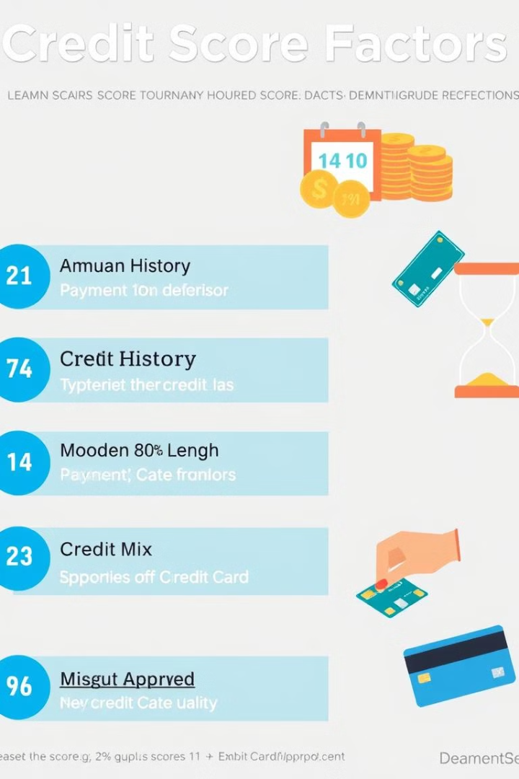
Key Drivers of Credit Scores
Payment History (35%)
On-time payments are crucial. Late payments can stay on your report for 7 years.
Amounts Owed (30%)
Credit utilization ratio is key. Keep it below 30%.
Credit History (15%)
A longer history is better. Avoid closing old accounts.
Credit Mix (10%)
Having a mix of credit types is good.

Slide 5




Machine Learning for Credit Score Prediction
Non-linear
Adaptable
Personalized
Machine learning captures non-linear relationships. It adapts to new data. It enables personalized predictions.
Common ML algorithms include Random Forests, Gradient Boosting Machines, and Neural Networks.

Slide 6
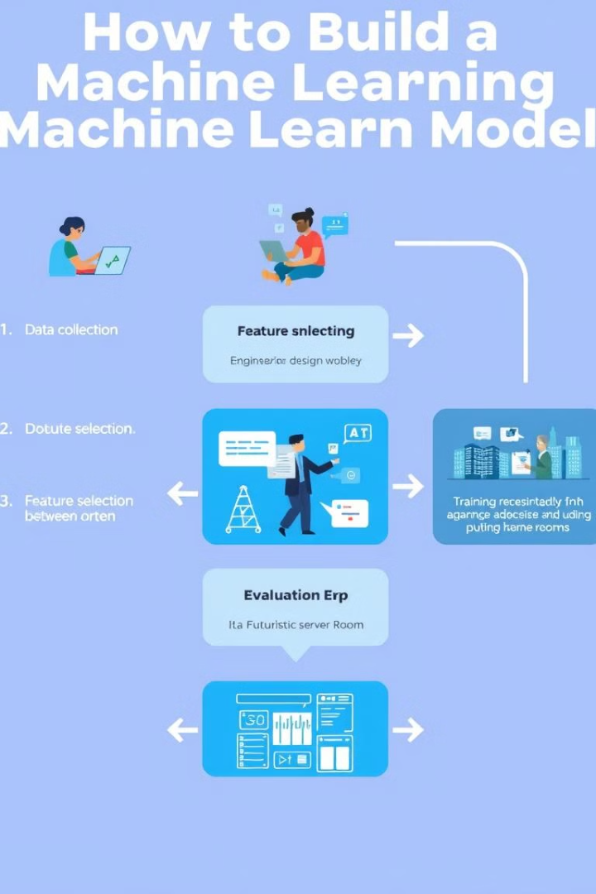



Building a Credit Score Prediction Model
1
Data Collection
Credit bureau data, demographic data, and transaction history are needed.
2
Feature Engineering
Create new features like payment ratio or credit age.
3
Model Training
Split data into training and testing sets.
4
Model Evaluation
Use metrics like accuracy, precision, and recall.

Slide 7



Results and Benefits
Improved Accuracy
1
ML models increase accuracy by 10-20%.
Deeper Insights
2
Identify key drivers of creditworthiness.
Business Benefits
3
Better risk management and increased profitability.
Personalized recommendations help improve scores. Default rates are reduced.

Slide 8





Conclusion: The Future of Credit Scoring
Transformation
Machine learning is transforming credit scoring.
Benefits
Benefits for consumers and lenders.
Trends
Alternative data sources.
Real-time
Real-time credit scoring.
The future is bright. Are there any questions?

Slide 9
Thank you

